Slide 1
Neural Layered BRDFs
Jeong Uk Lee

Slide 2
Unfamiliar terms
SVBRDF: Spatially varying BRDF. Surface of a material may have variations in its reflectance properties across its spatial dimensions.
Latent vector: used to represent data in a lower-dimensional space. This lower-dimensional representation aims to capture the essential features or information of the original data while reducing its dimensionality. This can help in reducing computational complexity and potentially removing noise or redundancy from the data.
Decoder: In context of this paper, decoder is a neural network that decodes latent vector to BRDF value.
Albedo: a measurement of how much incoming light is reflected by a surface, rather than being absorbed.

Slide 3
Unfamiliar terms
Extinction coefficient: a parameter used to describe how light is absorbed and scattered as it passes through a medium.
Back-propagation: backward pass to adjust a neural network model's parameters, aiming to minimize the mean squared error.
Dielectric: materials that don’t conduct electricity. They have real-valued indices of refraction and transmit a portion of the incident illumination. (e.g. glass)
Conductor: Metals. The material is opaque and reflects back a significant portion of the illumination.(In the context of this paper, think of it as the bottommost layer).
anisotropic: property of non-uniformity in different direction of view(i.e. view dependent).

Slide 4
Motivation
Bidirectional reflectance distribution functions (BRDFs) are pervasively used in computer graphics.
Many common materials in the real world have more than one layer(e.g. car paint, wood)
This paper address that and proposes a new technique for expressing BRDF for layered materials(i.e. neural layered BRDFs).

Slide 5
Previous works(layered BRDF)
Monte Carlo approaches[Guo et al. 2018] are able to produce high-quality results.
However, the cost is expensive and the random walk introduces noise(variance) especially when there are volumetric media between layers.
This paper uses it as ground truth.

Slide 6
Previous works(Neural Compression)
Neural Based BRDF compression(Rainer et al. [2019], Sztrajman et al. [2021], etc)
Uses neural network to compress data with high fidelity.
Specialized Methods : Need one neural network for each material/BRDF. (computationally expensive)
Generalized Methods : Unified model to represent all materials.(better efficiency at the expense of good quality)
None of them deals with layered materials.

Slide 7

Formulation
Represent individual BRDF in latent space.
Omegas represent incoming/outcoming directions of a ray.
Compress it into latent vector.

Slide 8

Formulation
After latent vectors for each layers are obtained, perform layering operation to get a single final latent vector for multi-layered surface.

Slide 9
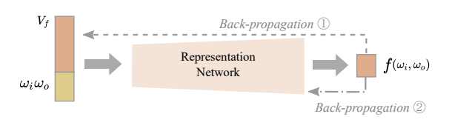
Neural BRDF representation
Design a general-purpose neural network that compresses BRDF into latent vector V.
Representation network that takes latent vector, incoming and outcoming directions as input and returns corresponding BRDF value.
The network is trained with back-propagation with dataset of BRDFs.

Slide 10
Neural BRDF representation
Two routes for back-propagation.
1 for updating the latent vector.
2 for updating the weights inside the network.
Network learns different latent vectors representing different BRDFs.

Slide 11
Neural BRDF representation
For newly inputted BRDF, freeze the parameters inside the network.
Back-propagate through route 1 to get the corresponding latent vector.

Slide 12
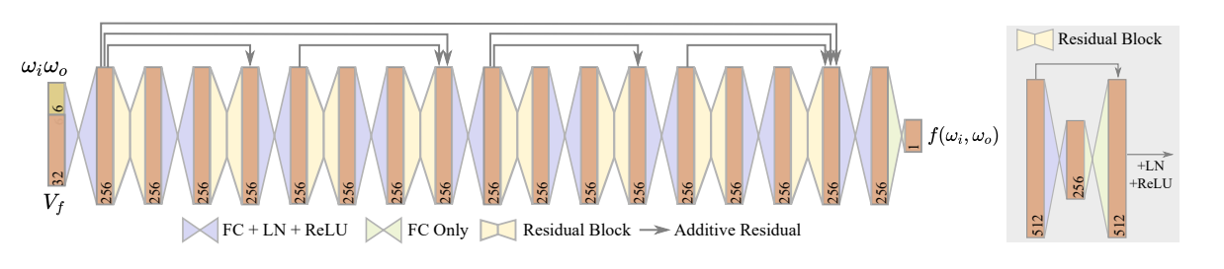
Neural BRDF representation
On top of this, the author defines a latent texture, where every texel is a latent vector representing BRDF, to deal with SVBRDF.

Slide 13
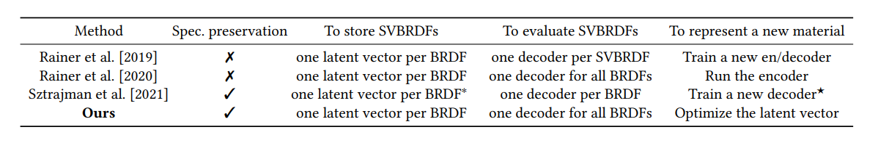
Comparison with previous works
Very generalized method.
Requires only one decoder(network) for all BRDFs.

Slide 14
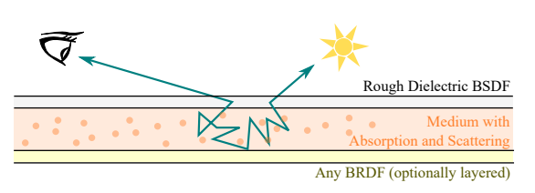
Neural BRDF layering
Top layer is a rough dielectric BSDF(some energy gets reflected, and some gets transmitted)
Layer of homogeneous participating media with albedo 𝐴 and extinction coefficient 𝜎.
We can have any BRDF for the bottom layer. Namely, we can have multiple layers at the bottom and they are represented by a single latent vector.

Slide 15
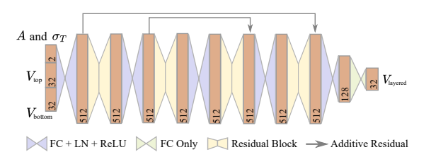
Neural BRDF layering
Similar network structure as the representation network.
Takes two latent vectors of layers, albedo, and extinction coefficient as input.
Outputs one target latent vector that represents the layered BRDF.

Slide 16
Datasets for training
Use Mitsuba renderer to generate 300 rough dielectric BRDFs, 300 rough conductor BRDFs.
Make 12720 layered BRDFs by randomly layering 2 layers.(BRDFs are calculated using Monte Carlo random walks).
1800 three-layered BRDFs for fine-tuning.

Slide 17

Training(Representation network)
Initialize all latent vectors to 1.
12000 layered BRDFs for training set.
720 layered BRDFs for validation set.
Use L1 loss.

Slide 18
Training(Layering network)
After representation network is fully trained, project 300 dielectric BRDF, 300 conductor BRDF, and 12720 layered BRDF to it and get latent vector forms.
With the corresponding latent vectors, train the layering network.
Use L1 loss.
Same number of training set and validation set.
Additional 1800 three layered BRDFs to fine-tune.

Slide 19
Real Use
Convert rough dielectrics, rough conductors into latent vectors using representation network.
Get latent vector for layered BRDF by using layered network.
Use the representation network to get BRDF value from latent vector.
Calculate the radiance of path tracing to get output images.

Slide 20
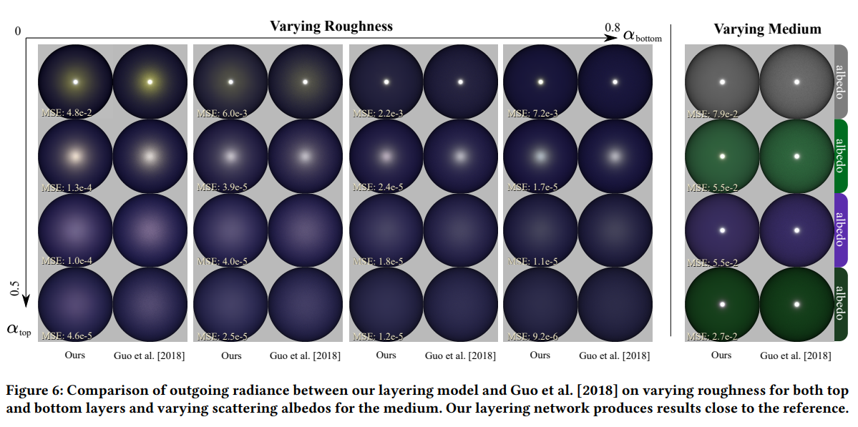
Results

Slide 21
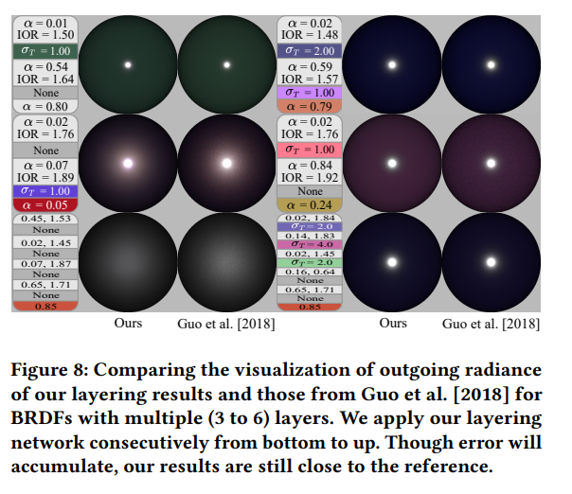
Results

Slide 22
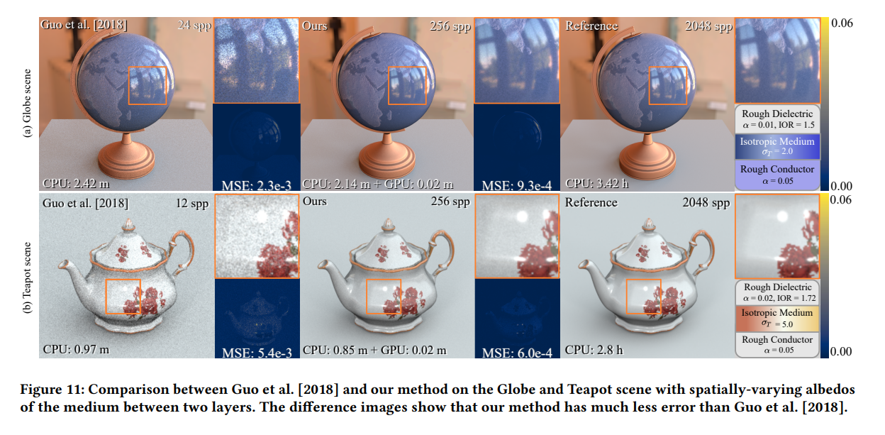
Results

Slide 23
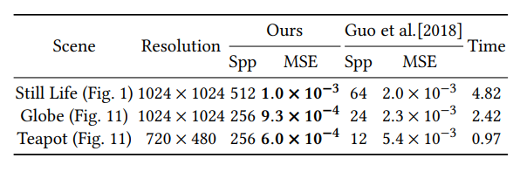
Strengths
Weakness
shows results that are noise-free.
Is a computationally efficient layered material evaluation approach.
Does not deal with anisotropic materials/media.
Does not deal with transmissive BTDF.

Slide 24
Quiz
How many neural networks are used in this paper?
  0
  1
  2
  3
___________ contains attributes such as albedo and extinct coefficient.
  Top layer
  Rough conductor layer
  Volumetric medium between layers
  Rough dielectric layer

Slide 25
Thank you!

